Slide 1
Secretariat of Infrastructure and Environment – SIMA
&
Forest Foundation
March 2022

Slide 2
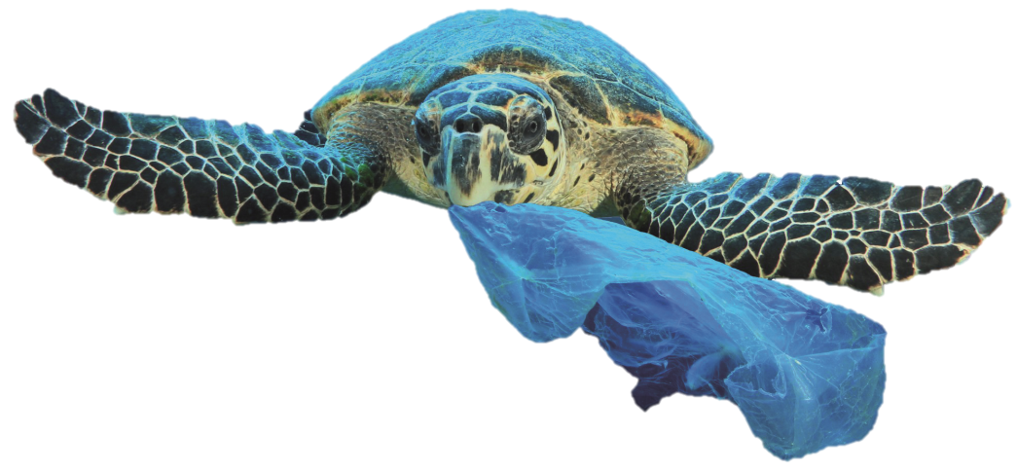
"MAR SEM LIXO" PROJECT
PAYMENT FOR ENVIRONMENTAL SERVICES - PES
for shrimp artisian fishermen operating inside marine protected areas from São Paulo State coast line

Slide 3
FOREST FOUNDATION- State Conservation Management Agency SP
What is a Protected Area?
A territorial space and its environmental resources (...) established by the Public Power, with conservation objectives and defined limits (...)
SNUC Federal Law 9.985/2000
Categories of Protected Areas
Full Protection - indirect uses
Sustainable Use - direct uses
Federal / State / Municipal
Protection of biodiversity, landscape, sustainable development
São Paulo State: 151 PAs – 4,7 mi HA

Slide 4
São Paulo Marine Environmental Protection Areas
Sustainable Use
50% of the territorial sea
Marine Areas, Islands, Beaches, Estuaries
> 1 million hectares
Resident population > 2 million
15 municipalities
APAMs - Decrees nºs 53.525, 53.526 e 53.527

Slide 5
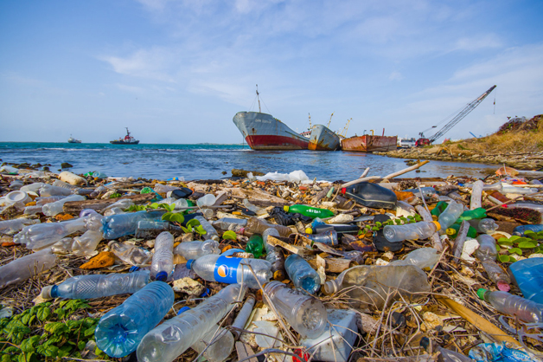
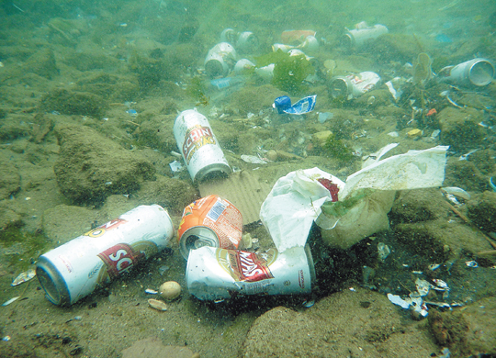
Marine Litter- A Global Problem
12 million tons of waste / year
80% plastic
1% of garbage stays on the surface or accumulates in coastal areas (beaches, estuaries and shores)
More than 99% - ocean bottom, seafloor and water column
Particles reach the seafloor fast < 100 km from point of surface dumping
Can remain intact (low UV and Oxygen)
Brazil: 16th country to dump waste at sea

Slide 6
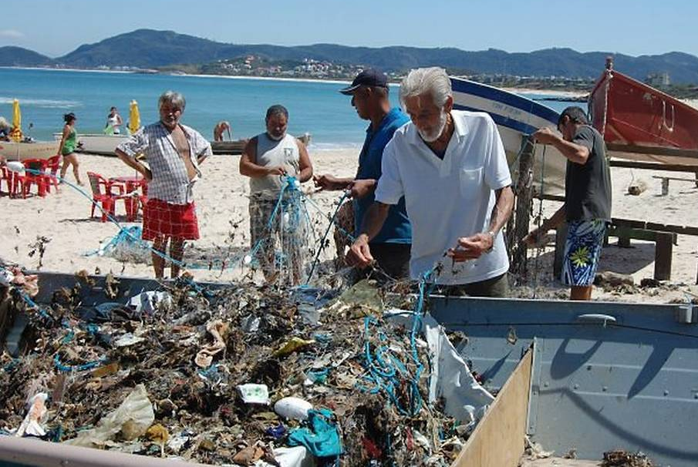
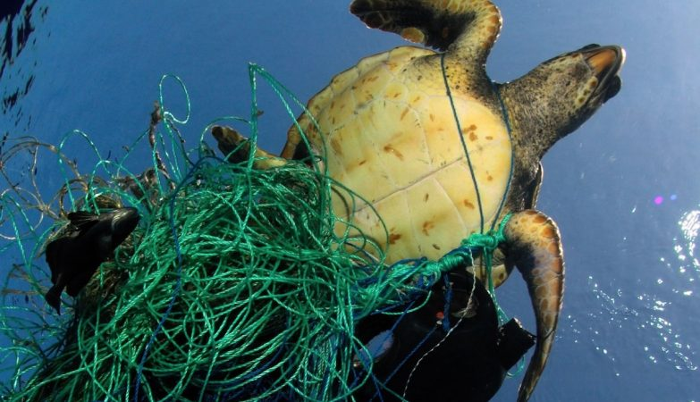
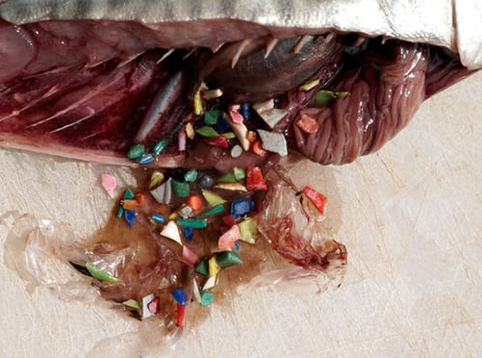
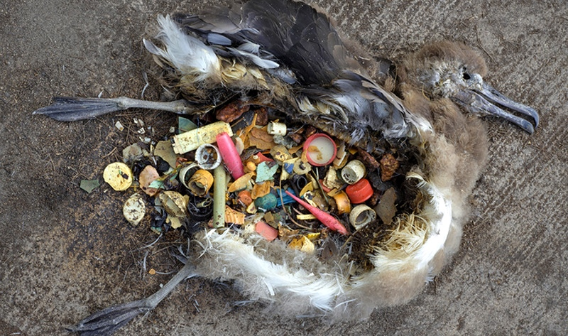
1,400 species affected
660 marine species - death by starvation and asphyxiation / day
90% of seabirds - plastics in their stomachs
Large marine animals that breathe on the surface - entanglement
Humans: ingestion of 0.1-5g microplastics weekly - global average
ENVIRONMENTAL AND SOCIO-ECONOMIC IMPACTS
Tourism
Fishing

Slide 7
Payment for Environmental Services – PES
STATE LAW Nº 14119, January 13th 2021
What are Environmental Services?
Individual or collective activities that help maintain, restore, or enhance ecosystem services;
What is PES?
A voluntary transaction between payer and provider
Who is the Provider?
Individual or legal entity, family or community group, that, meeting eligibility criteria, maintains, recovers or improves the environmental conditions of ecosystems.
Modalities
Direct payment, monetary or non-monetary, among others;
Policy objectives
III - valorize economically, socially and culturally the ecosystem services; VII - recognize individual or collective initiatives that favor the maintenance, recovery or improvement of ecosystem services

Slide 8
"MAR SEM LIXO" PES PROJECT
GENERAL OBJECTIVE :
To create an incentive mechanism for solid residues removal from the marine environment, accidentally captured during the artisanal fishing activity, remunerating fishermen for the environmental service, promoting its environmentally adequate destination, and promoting preventive actions to combat the disposal of waste at sea.
Component 1- Payment for Environmental Services - PES
Component 2 - Environmental Education and Communication
Component 3 - Monitoring, Evaluation and Research
Component 4 - Partnerships for Expansion and Financial Sustainability

Slide 9
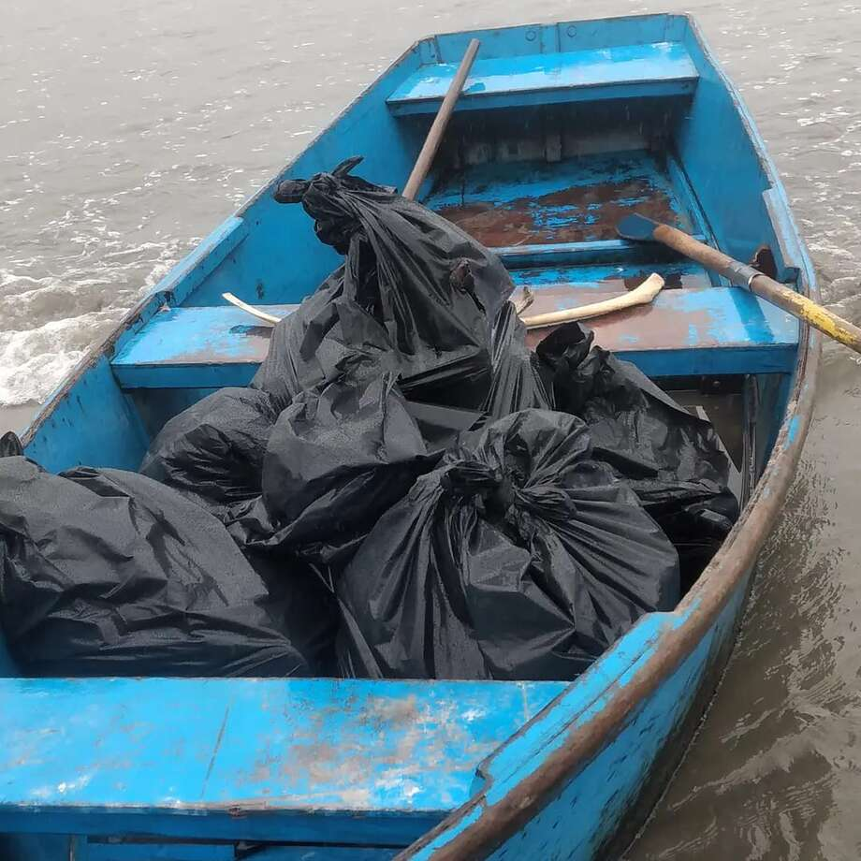
Component 1- Payment for Environmental Services - PES
__________________________________________________________________________________
PHASE 1 - Cananéia, Itanhaém, Ubatuba
Payer - Forestry Foundation
Provider - Artisanal fishermen of the shrimp trawl fishery
Environmental Service - removal of waste captured during fishing activity and proper disposal - reintroduction into the solid waste management chain
Modality - direct payment in food benefit
Measurement - weight x value / monthly

Slide 11
Component 1- Payment for Environmental Services - PES
__________________________________________________________________________________
Weight (kg of waste taken from the sea and delivered to the PRRM per fisherman per month) | Amount to be credited (R$ per fisherman per month)
Até 20kg/mês | zero
Acima de 20kg/mês | R$ 100
Acima de 50 kg/mês | R$ 150
Acima de 100 kg/mês | R$ 200
Acima de 200 kg/mês | R$ 250
Acima de 300 kg/mês | R$ 300
Acima de 400 kg/mês | R$ 400
Acima de 500 kg/mês | R$ 500
Acima de 600 kg/mês | R$ 600
Municipalities | Nº Fishermen | (R$) month | (Rs) year
Cananéia | 69 | 27.600 | 248.400
Itanhaém | 57 | 22.800 | 205.200
Ubatuba | 151 | 60.400 | 543.600
Total | 277 | 110.800 | R$ 997.200
Project Phase 1: 33% of total

Slide 12
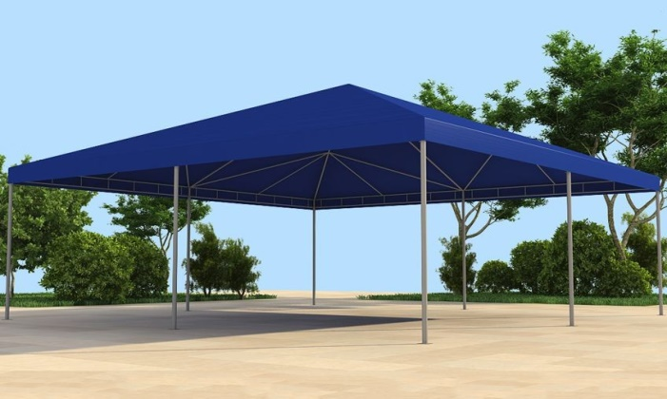
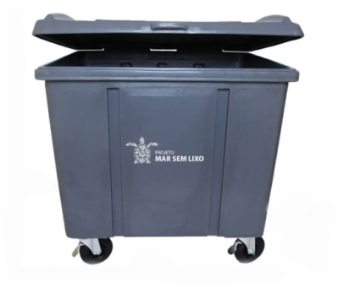
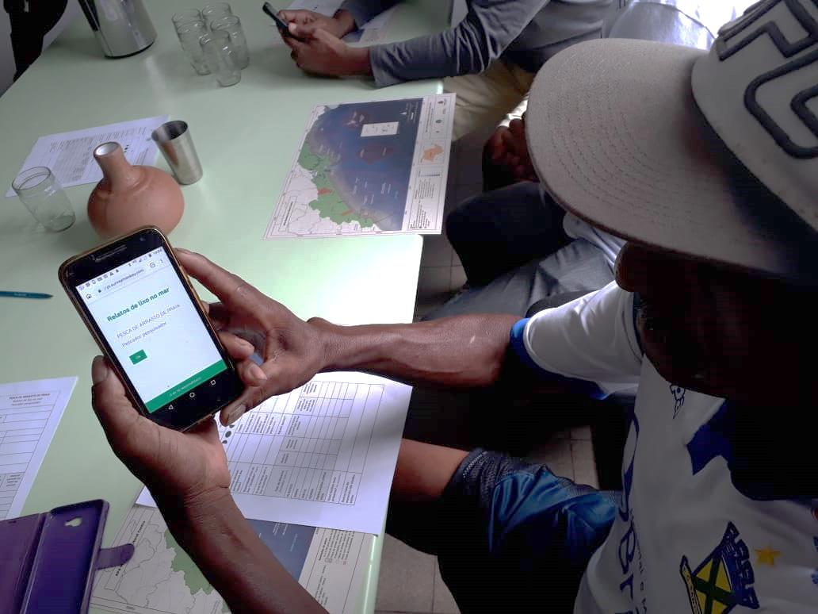
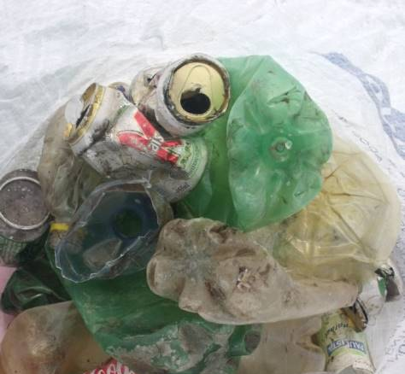
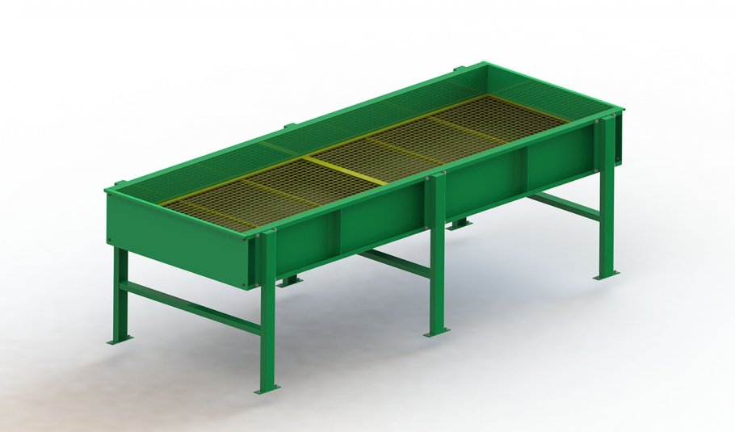
Component 1- Payment for Environmental Services - PES
__________________________________________________________________________________

Slide 13
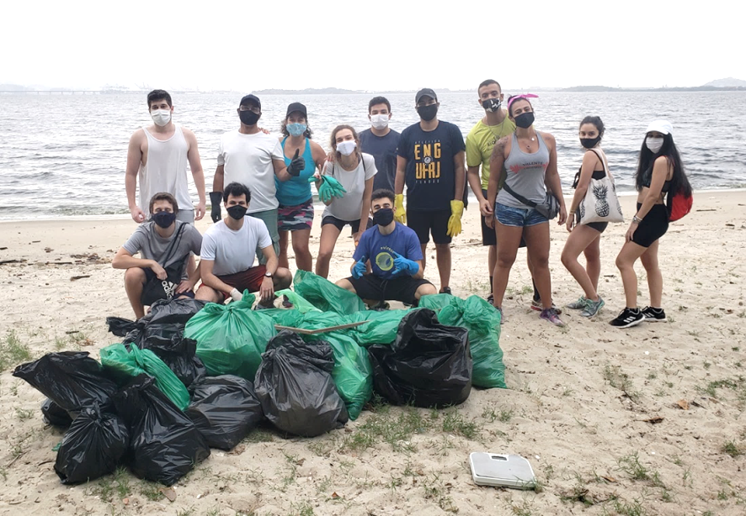
Component 2 - Environmental Education (EE) and Communication
Beach, river and coastal cleaning campaigns
Campaign for the replacement of plastic containers and isopores with the local commerce
Support to the collectors' cooperatives
Ecobarriers
EE in schools
Campaigns in cities and social networks
In partnership with municipalities and other partners

Slide 14
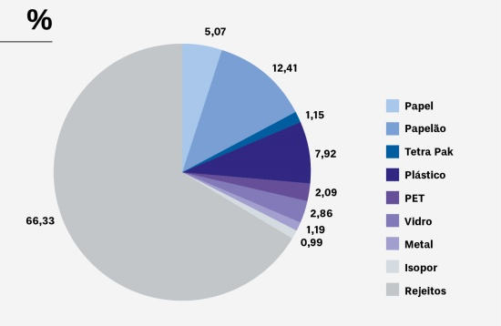
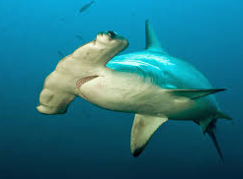
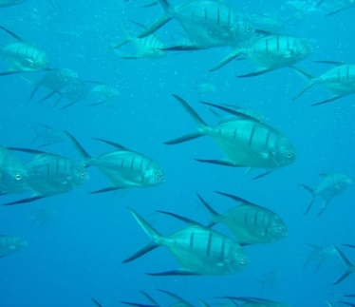
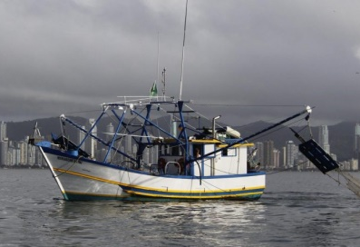
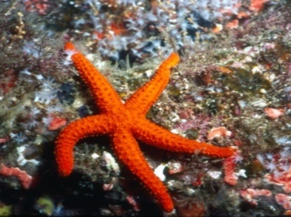
Component 3 - Monitoring, Evaluation and Research
Availability of project data for researchers - new or existing partnerships.
Objective - create synergy with the Research Programs of the PAs, Oceanographic Institute/USP, Fishing Institute and other researchers, and PEMALM.

Slide 15
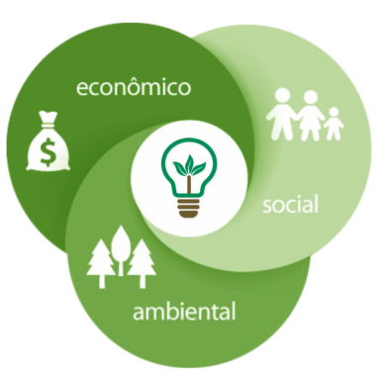
Component 4 - Partnerships for Expansion and Financial Sustainability
__________________________________________________________________________________
Temporal expansion - Guarantee the maintenance and improvement of the project
Territorial expansion - Include the 15 coastal municipalities
Expansion of the action fronts - Add new fronts and strategic actions
1st Call for Sponsorships
Actions:
All environmental education and communication activities
Packaging Replacement
Structuring of Refuse Collectors' Cooperatives
Installation of selective collection garbage cans
R$ 2.000.000,00

Slide 16
Principais parcerias institucionais
Forest Foundation
Municipalities
SIMA
CPLA, CS
Fishermen
Formal relationship with FF
Waste picker cooperatives
formal relationship with Municipalities
Oceanographic Institute - São Paulo University - USP

Slide 17
Credits
General Coordination:
RODRIGO LEVKOVICZ– DE FF
Technical Coordination:
JOANA FAVA CARDOSO ALVES – FF/DE
SANDRA APARECIDA LEITE – FF/DE
Drafting Team:
ANA MARIA NEVES – SIMA/CPLA
FERNANDA NADER – SIMA/CPLA
JOANA FAVA CARDOSO ALVES – FF/DE
LETÍCIA QUITO – FF/DLS/APAMLS
MARCIO JOSÉ DOS SANTOS – FF/DLN/APAMLN
MARIA DE CARVALHO T. LANZA – FF/DLN/APAMLC
MARIA FERNANDA ROMANELLI – SIMA/CPLA
MARIA TERESA CASTILHO MANSOR – SIMA/CPLA
MARINA BALESTERO DOS SANTOS – SIMA/CPLA
SANDRA APARECIDA LEITE – FF/DE
Contributors:
ADRIANA NEVES DA SILVA – FF/AT-EA
ALEXANDER TURRA - IOUSP
ISADORA PARADA – SIMA/CPLA
LUCILA PINSARD VIANNA – FF/DLN
NICOLE GUERRATO – FF/APAMLC
PRISCILA SAVIOLO MOREIRA – FF/PEIA
SIMONE NEIVA - FF/DMI
TANA BASSI – SIMA/CS
VANESSA PUERTA VERULI – FF/AT-EA
VITORIA MILANEZ SCRICH - IOUSP
Institutional Contributors:
INSTITUTO DE PESCA
INSTITUTO OCEANOGRAFICO
PREFEITURA DE CANANÉIA
PREFEITURA DE CARAGUATATUBA
PREFEITURA DO GUARUJÁ
PREFEITURA DE ITANHAÉM
PREFEITURA DE SÃO SEBASTIÃO
PREFEITURA DE UBATUBA

Slide 18
PUBLIC CONSULTATION
Objective: To collect contributions for the improvement of the "MAR SEM LIXO Payment for environmental services " document and to register potential partnership interest.
From January 19 until February 20, 2022
available at https://www.infraestruturameioambiente.sp.gov.br/fundacaoflorestal/2022/01/consulta-publica/

Slide 19
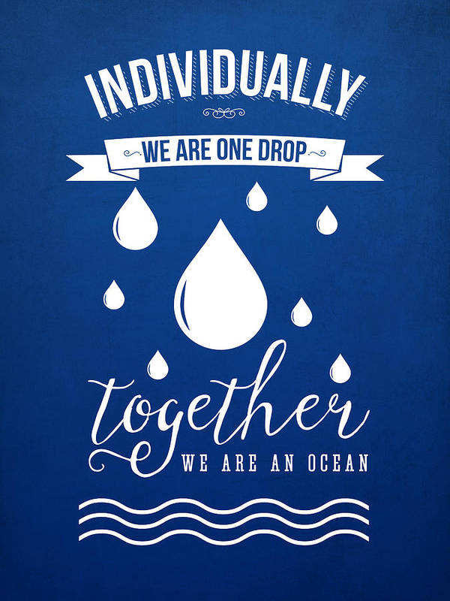
PUBLIC CONSULTATION
Expression of Interest
Types of partnerships:
Technical Cooperation
NGOs, SC Associations, Public Agencies, Research Institutes
Volunteers
Sponsorships and donations

Slide 20
"MAR SEM LIXO" PROJECT
PAYMENT FOR ENVIRONMENTAL SERVICES - PES
TO THE SHRIMP ARTISANAL FISHERMEN OF TRAWLING ACTING IN THE MARINE PAs OF SÃO PAULO
FOREST FOUNDATION - SIMA /SP
https://www.infraestruturameioambiente.sp.gov.br/fundacaoflorestal/psa-lixo-no-mar/
Contacts: Joana Fava Cardoso Alves / Sandra Aparecida Leite

